Slide 1


M.Tech/MCA Program
Advanced Industry Integrated Programs
Jointly offered by University and LTIMindTree
Review III
Real-Time AI-Driven Road Accident Detection and Emergency Alert System
Patel Vishrutkumar Dineshbhai
T-ID No: T8544
Knowledge partner | Implementation partner

Slide 2
Real-Time AI-Driven Road Accident Detection and Emergency Alert System
Introduction…
Manual monitoring of CCTV for road accidents is slow and inefficient.
Delayed emergency response is a critical factor in accident outcomes.
This project presents a fully automated, AI-powered system to solve this problem.
It analyzes live video to instantly detect accidents, classify their severity, and trigger real-time alerts.

Slide 3
Real-Time AI-Driven Road Accident Detection and Emergency Alert System
Objective….
Detect accidents in real-time from live video feeds.
Classify accident severity into Low, Medium, or High.
Build a complete end-to-end system, from video input to a web dashboard.
Implement a real-time alerting workflow using WebSockets and SMS (Twilio)/Email.
Create a "human-in-the-loop" supervisor dashboard to verify and manage alerts.

Slide 4
Real-Time AI-Driven Road Accident Detection and Emergency Alert System
Problem Statement….
Manual monitoring of traffic cameras is not scalable and leads to slow detection times.
This latency delays medical and emergency response.
First responders often lack initial information on the severity of an incident.
Solution: An automated system that provides instant detection and immediate severity assessment to enable a faster, more informed response.

Slide 5
Real-Time AI-Driven Road Accident Detection and Emergency Alert System
Methodology….
Data Collection: Labeled 607 accident videos for frame ranges and severity.
Feature Extraction: Used YOLOv10m and BoTSORT to extract vehicle tracks.
Feature Calculation: Programmatically generated multimodal features (IOU, deceleration, etc.).
Model Training: Trained a Multimodal Vision Transformer (ViT) with GRUs.
System Integration: Built a full-stack application (Flask, SQLite, Streamlit).
Live Deployment: Deployed the full pipeline locally to analyze a webcam feed in real-time.

Slide 6
Real-Time AI-Driven Road Accident Detection and Emergency Alert System
Approach/Algorithms/Tools…
AI Algorithms:
Vision Transformer (ViT): For visual feature extraction from frames.
Gated Recurrent Units (GRU): For understanding temporal motion patterns.
YOLOv10m & BoTSORT: For state-of-the-art object detection and tracking.
Core Technologies:
Python: Primary programming language.
PyTorch & Timm: Deep learning framework.
Flask & Socket.IO: Backend API and real-time server.
Streamlit: Interactive web dashboard.
SQLite: Local relational database.
Twilio API: SMS notification service.
Gmail SMTP: Email notification service.

Slide 7
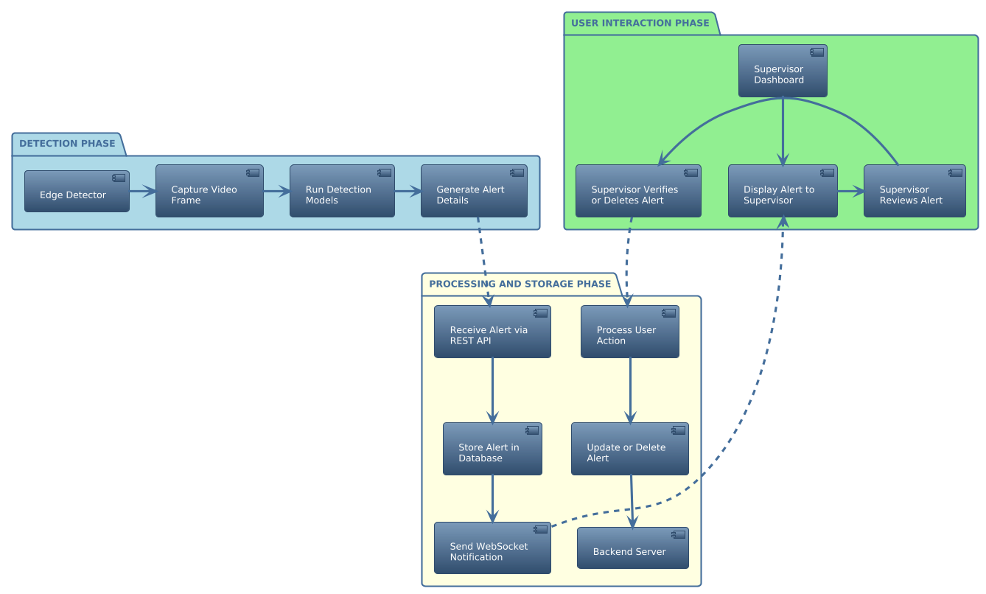
Real-Time AI-Driven Road Accident Detection and Emergency Alert System
System Architecture…
[System Architecture Diagram]

Slide 8
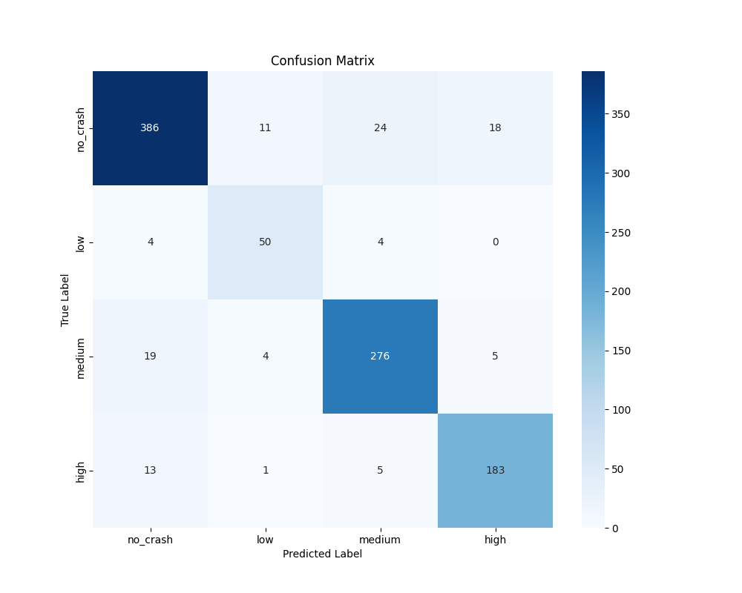
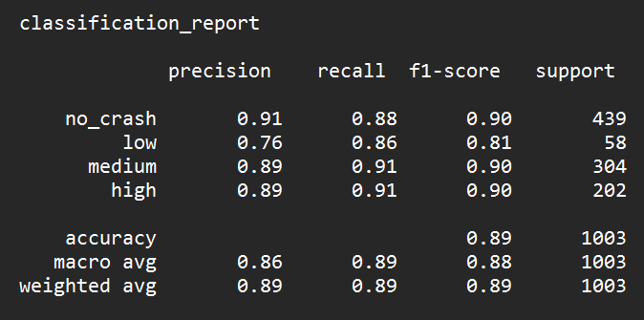
Real-Time AI-Driven Road Accident Detection and Emergency Alert System
Findings and Results…
Quantitative Results:
Achieved 89% accuracy on the validation dataset.
High performance on High and Medium severity classes (F1-score: 0.90).
Identified Low severity as the most challenging class, as expected.
[Classification Report]
[Confusion Matrix]

Slide 9
Real-Time AI-Driven Road Accident Detection and Emergency Alert System
Findings and Results…
System Performance:
The live system successfully detects simulated accidents with high confidence.
The dashboard is fast and responsive due to caching and soft-refresh logic.
Key Finding (Domain Shift):
Observed false positives on out-of-domain data (e.g., a human face).
This result proves the critical importance of a "human-in-the-loop" to verify alerts, which has been successfully implemented in our system design.

Slide 10
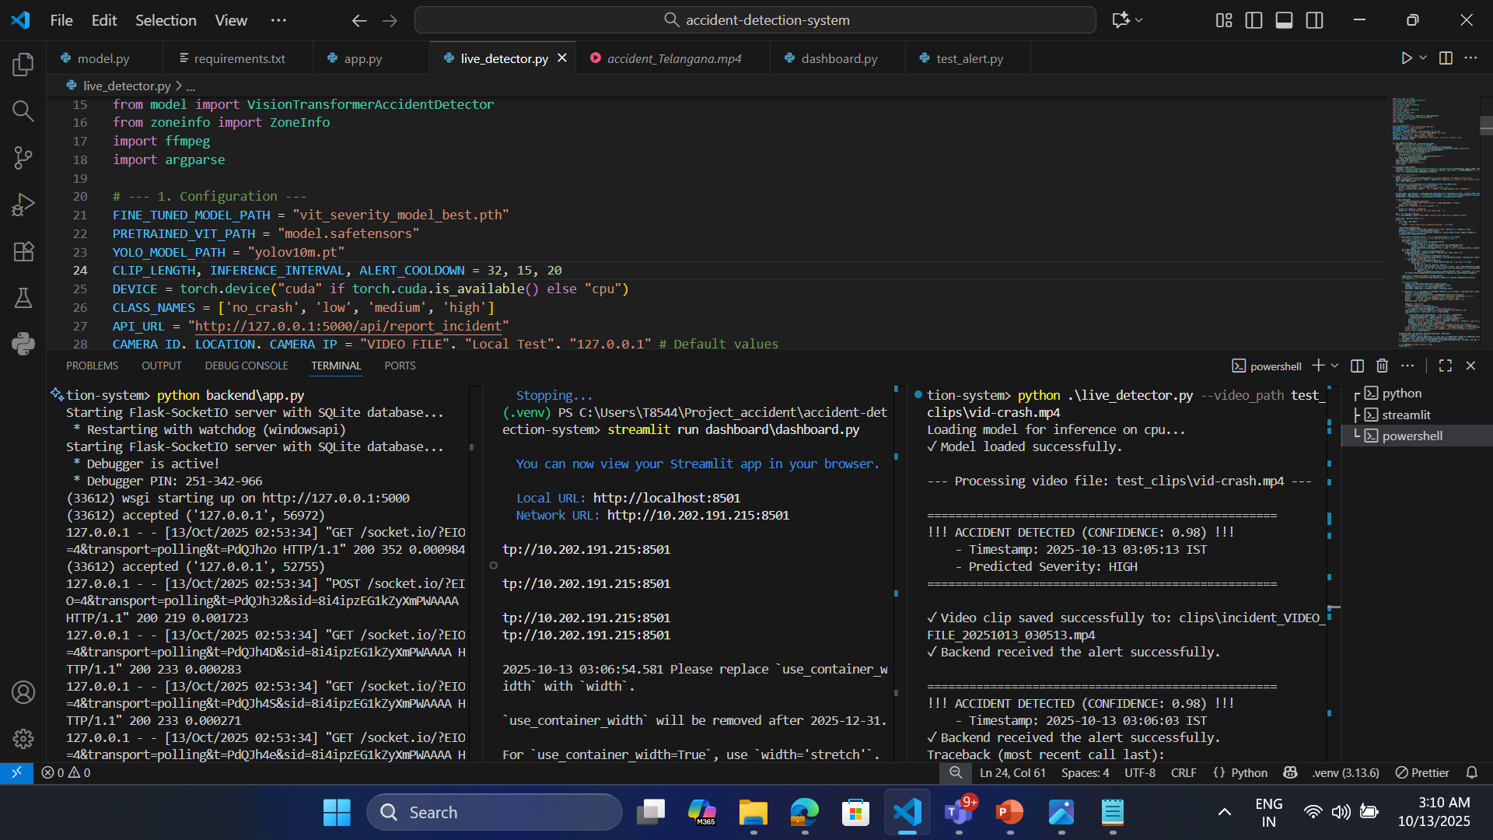
Real-Time AI-Driven Road Accident Detection and Emergency Alert System
Demo (Terminal Output)

Slide 11
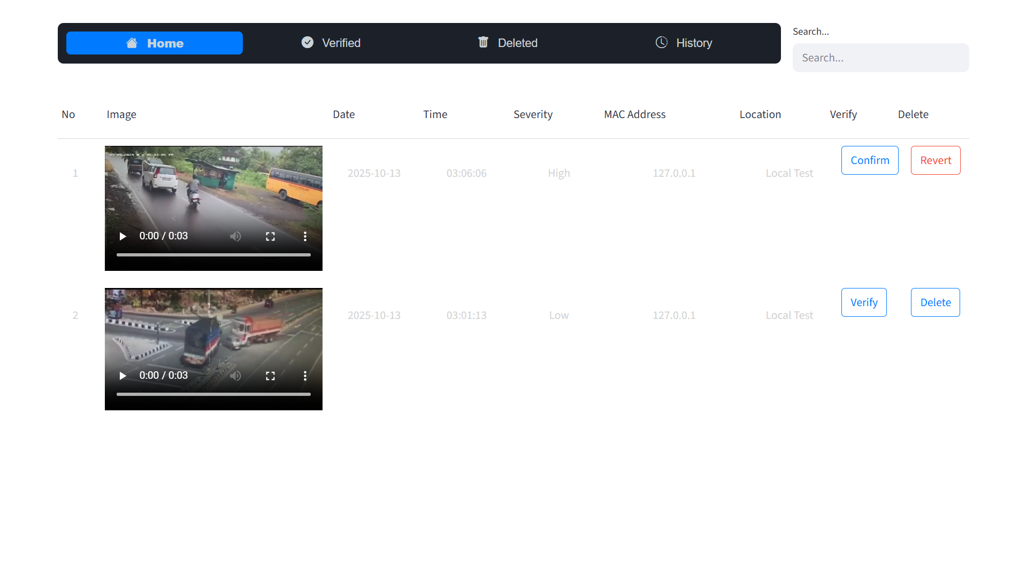
Real-Time AI-Driven Road Accident Detection and Emergency Alert System
Demo (UI)

Slide 12
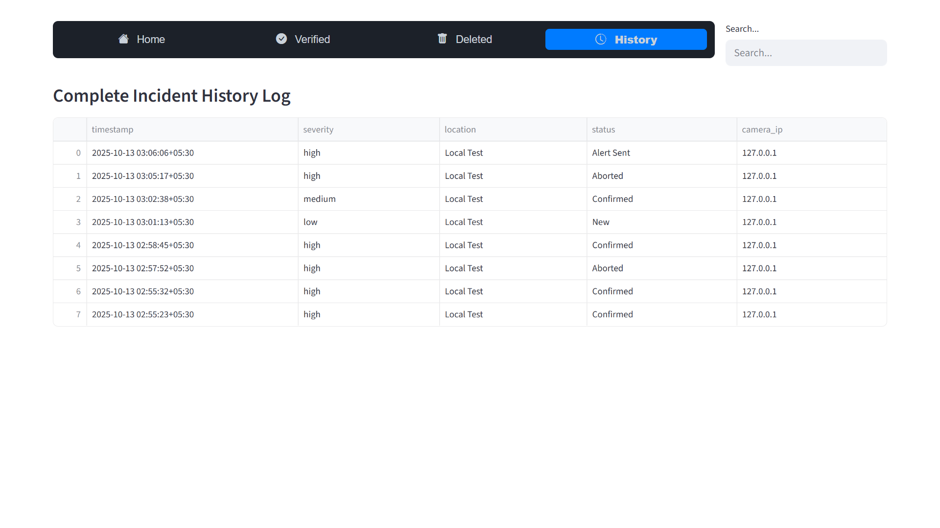
Real-Time AI-Driven Road Accident Detection and Emergency Alert System
Demo (UI)

Slide 13
Real-Time AI-Driven Road Accident Detection and Emergency Alert System
Conclusion…
Successfully built and demonstrated a complete, end-to-end system for real-time accident detection and severity classification.
The system achieves high accuracy and integrates a professional, real-time alerting workflow with a human-in-the-loop for verification.
Future Work:
Expand Training Data: Add more "low" severity and "hard negative" examples.
Cloud Deployment: Containerize the services with Docker for deployment on platforms like AWS/Azure.
Accident Hotspot Analysis and Reporting

Slide 14
Real-Time AI-Driven Road Accident Detection and Emergency Alert System
Acknowledgement…
I would like to express our sincere gratitude to our project mentors, Hari sir and J. K. sir for their invaluable guidance and support.
I also thank LTIMindTree and Vellore Institute of Technology for this opportunity.

Slide 15
Real-Time AI-Driven Road Accident Detection and Emergency Alert System
Reference…
[1] A. P. Shah, J.-B. Lamare, T. Nguyen-Anh, and A. Hauptmann, “CADP: A Novel Dataset for CCTV Traffic Camera based Accident Analysis,” in Proc. IEEE Int. Workshop on Advanced Video and Signal Based Surveillance (AVSS), 2018, pp. 1–9, doi:10.1109/AVSS.2018.8639160
[2] P. Pradeep Kumar and K. Kant, “TU-DAT: A Computer Vision Dataset on Road Traffic Anomalies,” Sensors, vol. 25, no. 11, Art. 3259, 2025, doi:10.3390/s25113259
[3] H. Liao et al., “CRASH: Crash Recognition and Anticipation System Harnessing with Context-Aware and Temporal Focus Attentions,” in Proc. ACM Int. Conf. on Multimedia (MM), 2024, doi:10.1145/3664647.3680672
[4] J. Wang et al., “YOLOv10: Real-Time End-to-End Object Detection,” arXiv preprint arXiv:2405.14458, May 2024.
[5] N. Aharon, R. Orfaig, and B. Bobrovsky, “BoT-SORT: Robust Associations for Multi-Pedestrian Tracking,” arXiv preprint arXiv:2206.14651, Jun. 2022.

Slide 16
Real-Time AI-Driven Road Accident Detection and Emergency Alert System
Thank You!

